Slide 1


APB AVIP
Phoenix Team,
Maruthi Vangalli
Sahana P
Shaik Nadeem Ahmed
Shweta Patil
Sivareddy Kostam

Slide 2
Contents
Introduction
Key Features
APB4 Interface
Planning Phase
Implementation
APB Flow Chart
Flowcharts
Output
Waveform
Coverage
Demo
References

Slide 3
Introduction

Slide 4
APB is part of the AMBA (Advanced Microcontroller Bus Architecture) protocol family.
It defines a low-cost interface that is optimised for minimal power consumption and reduced interface complexity.
Not pipelined, used to connect to low-bandwidth peripherals.
APB can be interfaced with AHB, AHB-lite, AXI and AXI4.
Used to access the programmable control registers of the peripheral devices.

Slide 5
KEY FEATURES

Slide 6
It supports addresses up to 32 bit wide.
APB4 support for write strobe signal to enable data transfer on the write data bus.
Single Master - Single Slave.
Programmable wait state insertion.
Random PSLVERR insertion.
User preferred read-data configuration.
In APB, every transfer takes at least two cycles (Setup Phase and Access Phase).
Supports Memory Mapping

Slide 7
APB4 INTERFACE

Slide 8
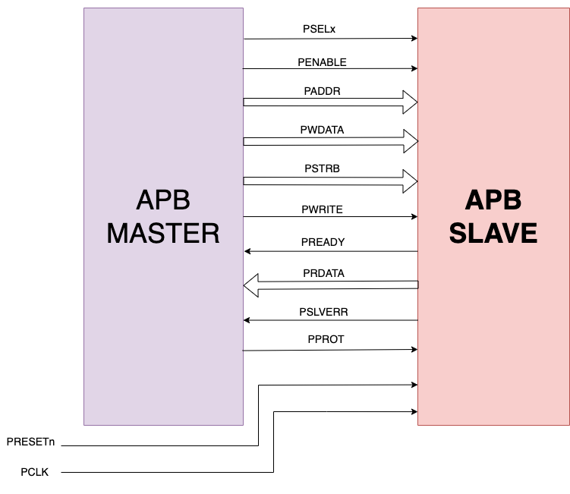

Slide 9
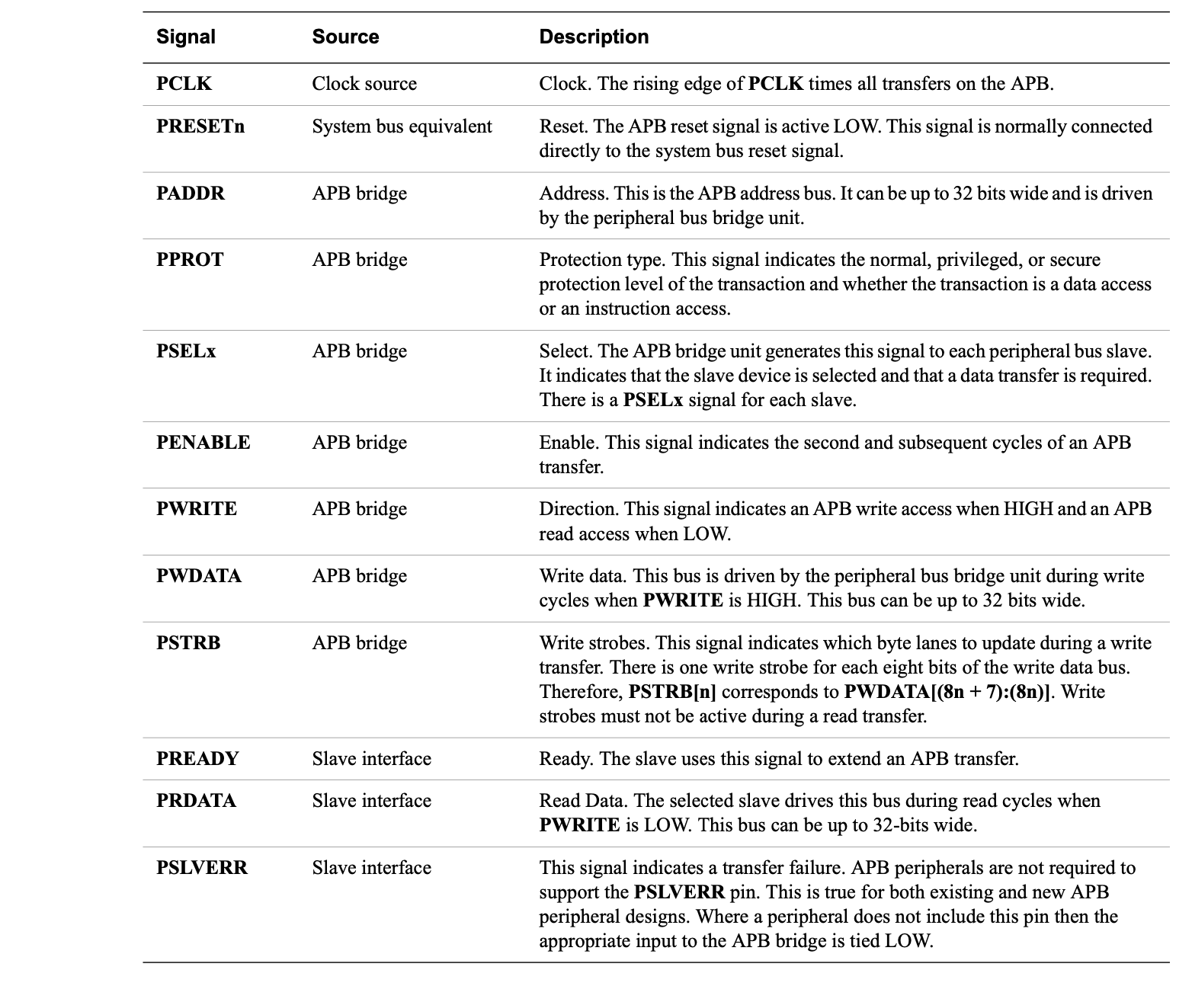

Slide 10
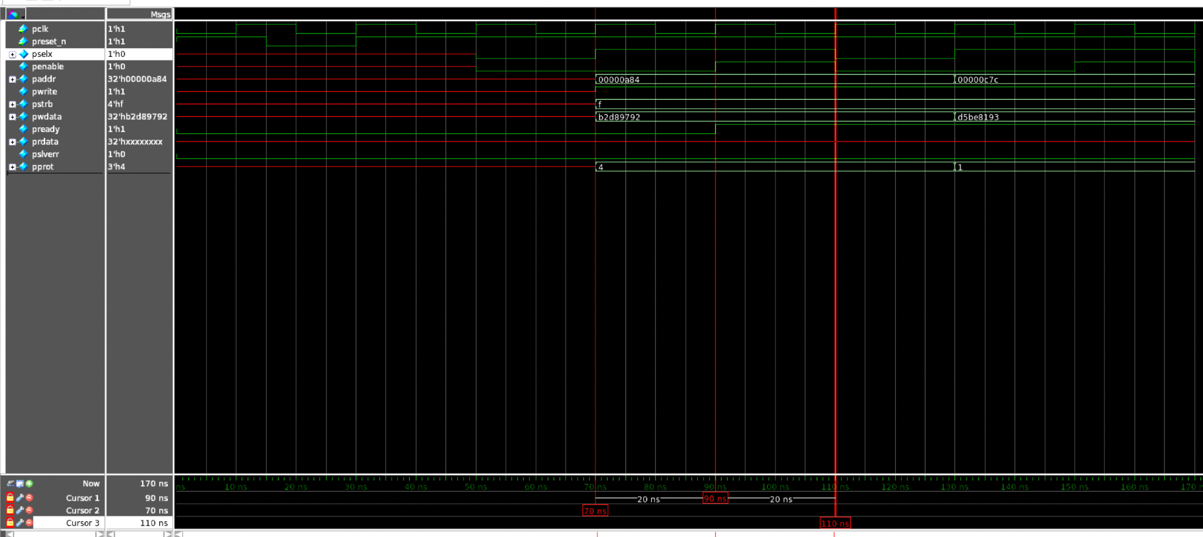
Basic APB timing diagram

Slide 11
PLANNING PHASE

Slide 12
Verification Plan -> apb_avip_verification_plan
Coverage Plan -> apb_avip_coverage_plan
Assertion Plan -> apb_avip_assertion_plan

Slide 13
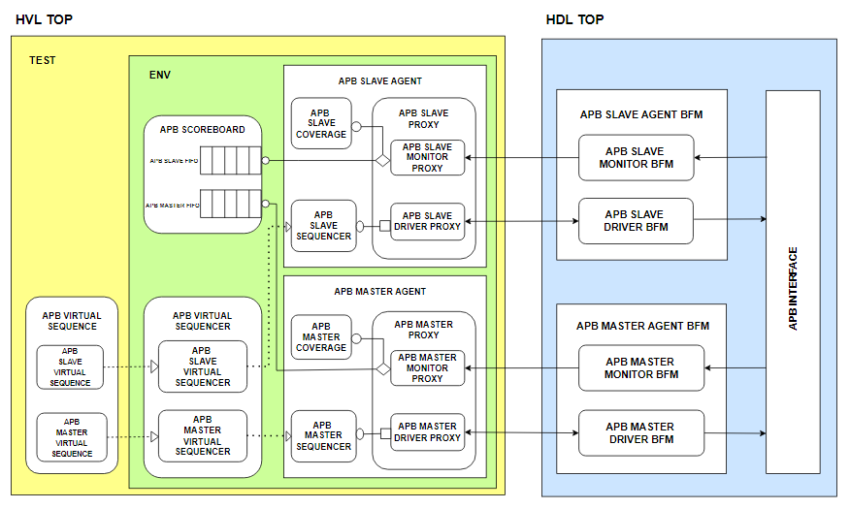

Slide 14
Implementation

Slide 15
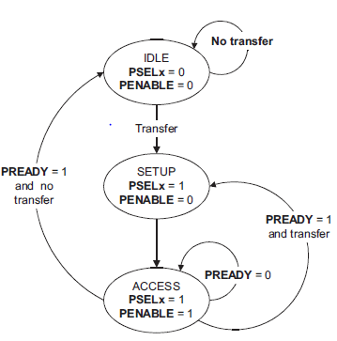
APB Flowchart

Slide 16
Flowcharts
Master Driver -> apb_avip_master_driver_flowchart
Slave Driver -> apb_avip_slave_driver_flowchart
Master Monitor -> apb_avip_master_monitor_flowchart
Slave Monitor -> apb_avip_slave_monitor_flowchart
Scoreboard Run Phase -> apb_avip_run_phase_flowchart
Scoreboard Check Phase -> apb_avip_check_phase_flowchart

Slide 17
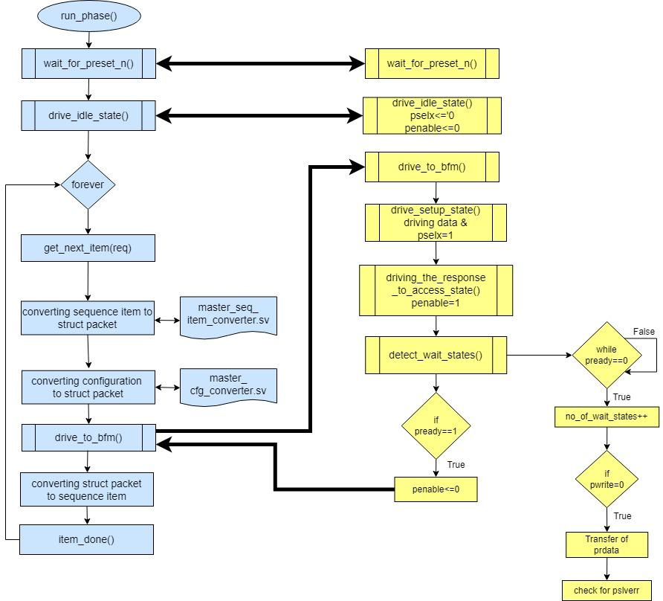
Master Driver BFM-Proxy Communication Flowchart

Slide 18
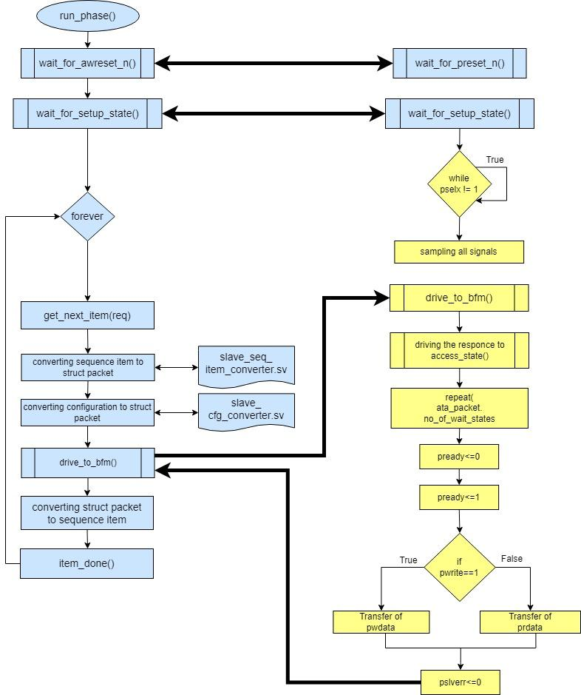
Slave Driver BFM-Proxy Communication Flowchart

Slide 19
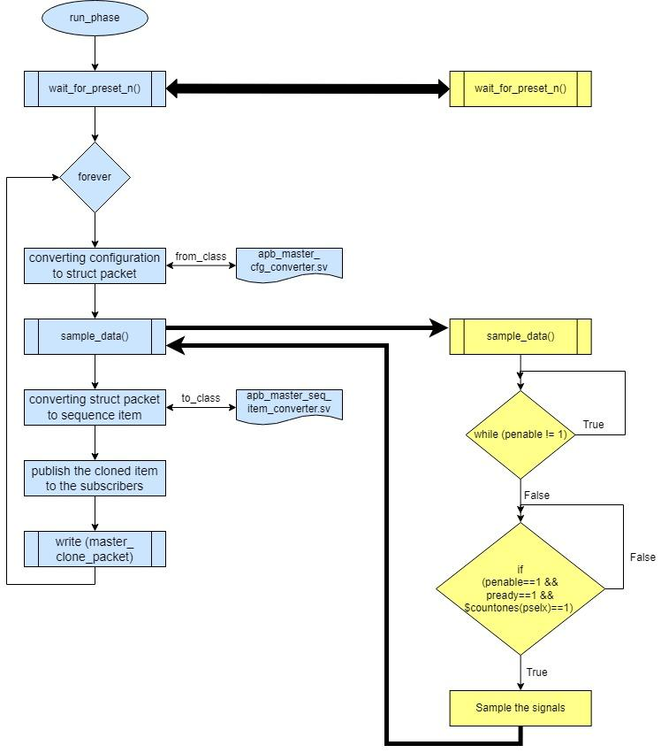
Master Monitor BFM-Proxy Communication Flowchart

Slide 20
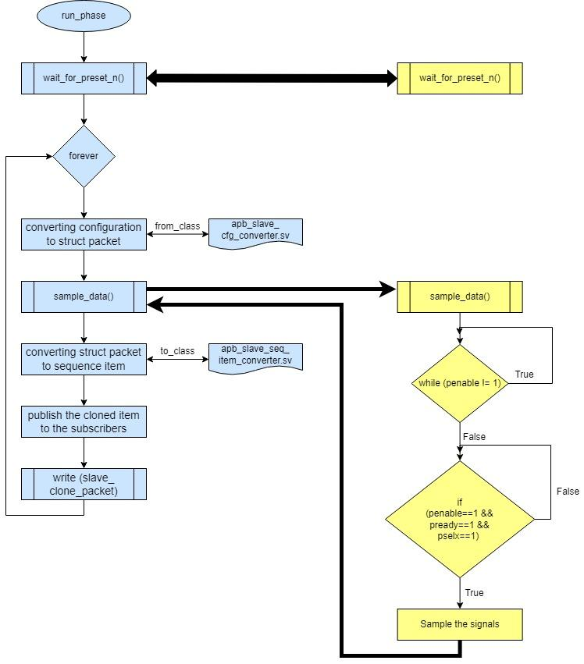
Slave Monitor BFM-Proxy Communication Flowchart

Slide 21
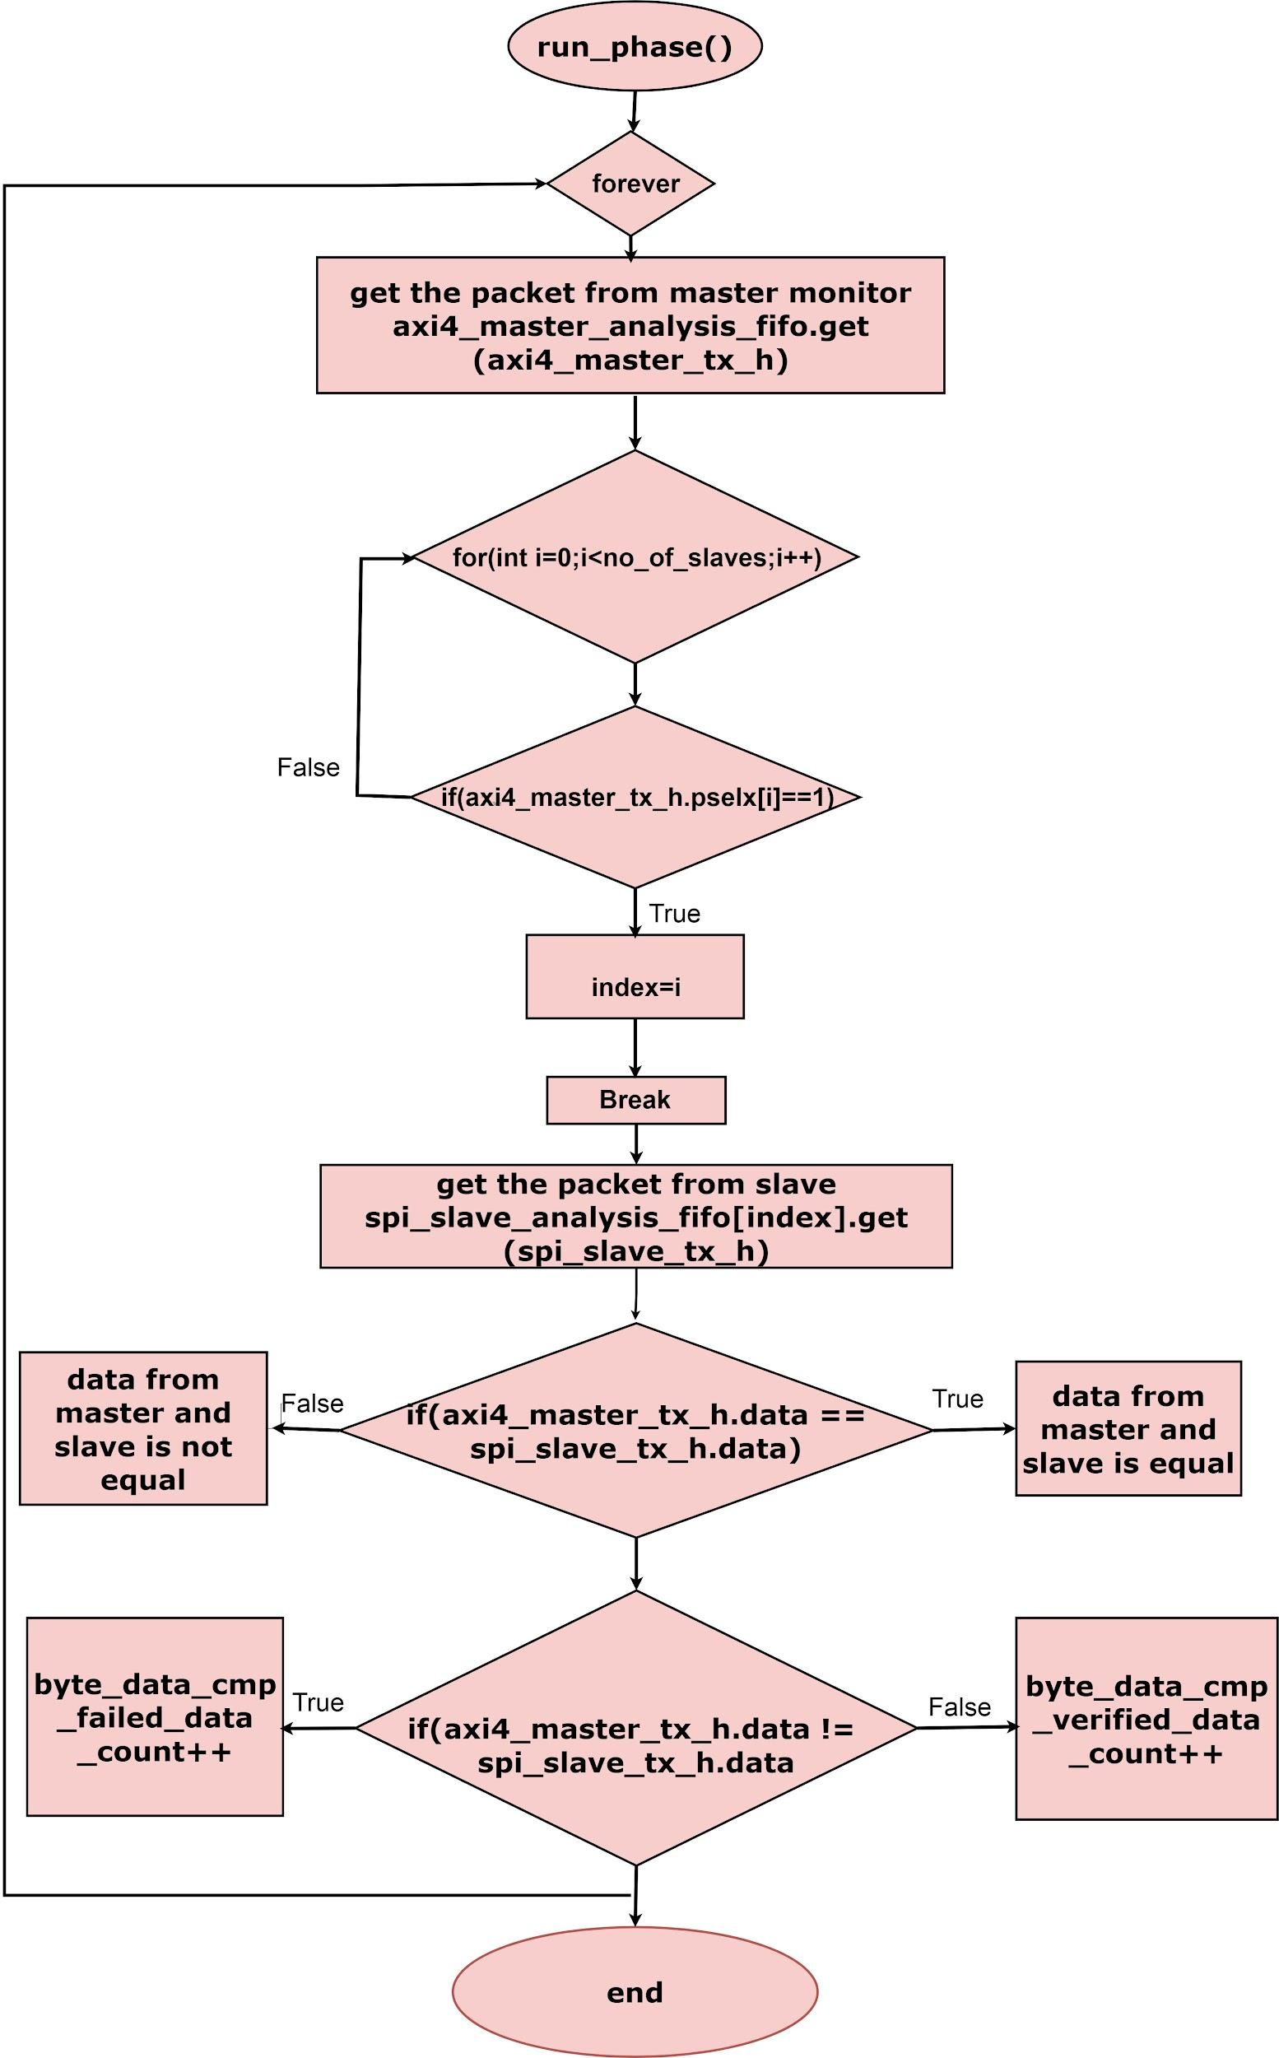
Scoreboard - Run Phase Flowchart

Slide 22
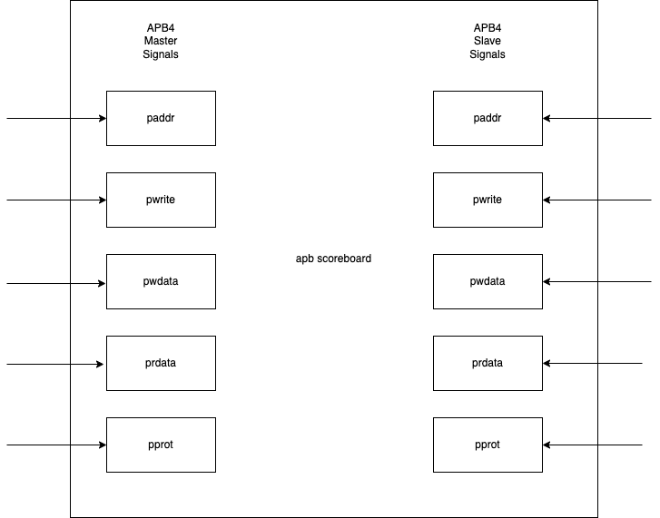
APB Scoreboard

Slide 23
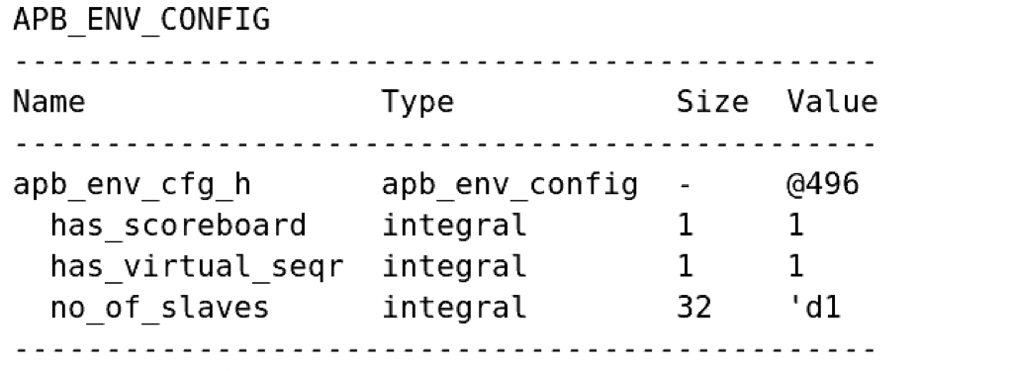
APB Environment Configuration

Slide 24
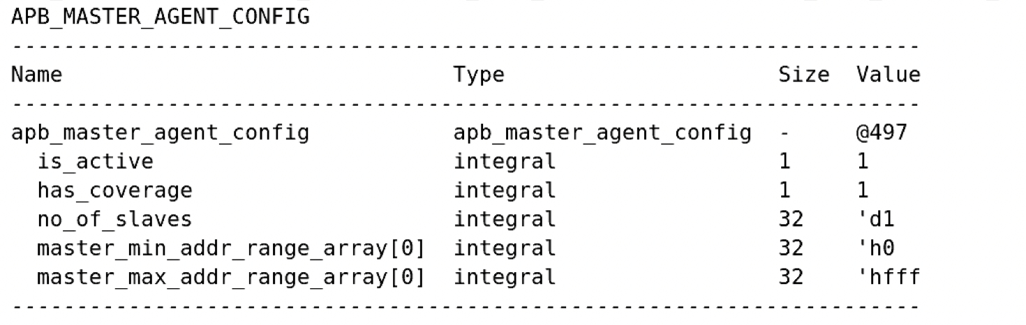
APB Master Agent Configuration

Slide 25
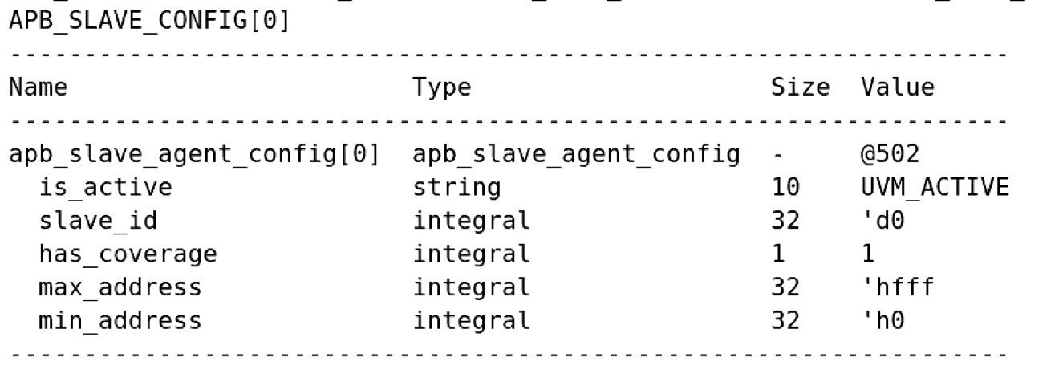
APB Slave Agent Configuration

Slide 26
OUTPUT

Slide 27
OUTPUT WAVEFORM

Slide 28
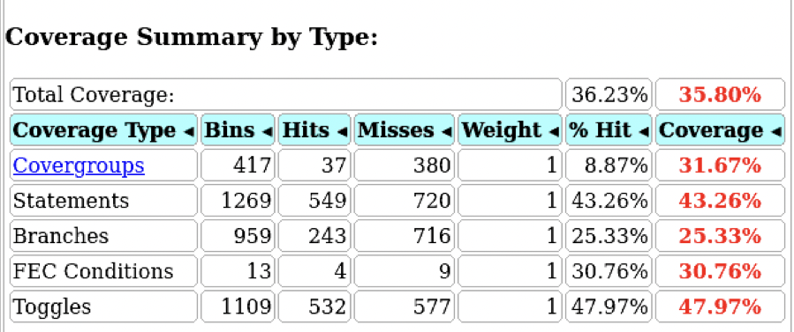
Coverage

Slide 29
DEMO

Slide 30
References
APB TB ARCHITECTURE DIAGRAM
APB TB DOCUMENT
APB_AVIP_USER_GUIDE
APB GITHUB LINK

Slide 31
Q & A

Slide 32
Thank You

